Slide 1
FBLA ChapterManager
Mobile Application Development
Francis Howell North HS
By Marcus Otto and Luke Coffman

Slide 2
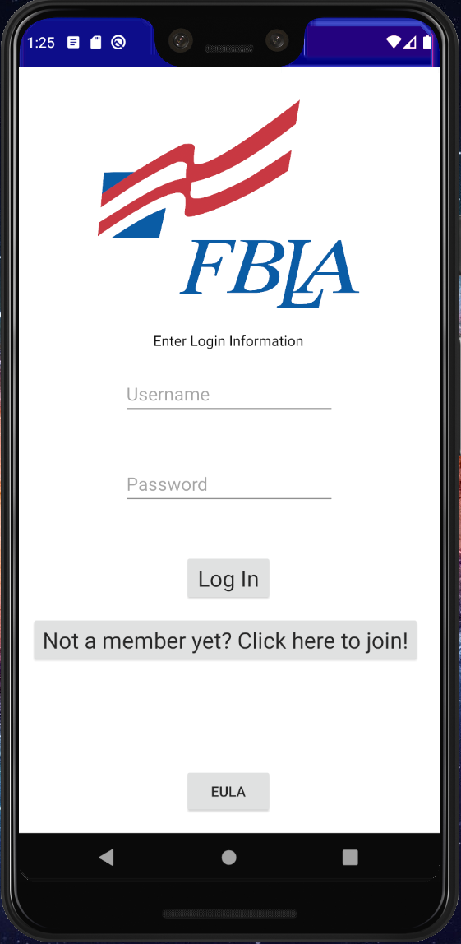
Application Overview
Some of the main features include:
Resources for the public
Link to a form to join FBLA
Link to the FBLA website to learn more information about FBLA
A Q&A to answer some common questions
Contact information for the chapter advisor and social media links
Resources for current members
Calendar of events and deadlines
List of FBLA competitive events as well as a link to sign up for them
Contact information for the chapter advisor and social media links
List of officers
Resources for the chapter advisor
The ability to record attendance at every meeting/event

Slide 3
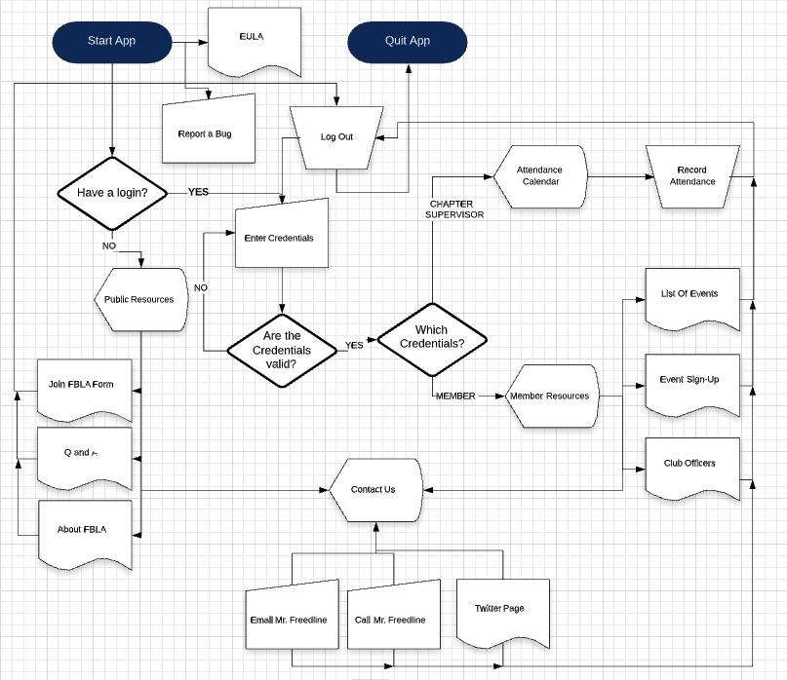
Application
Flow
Chart

Slide 4
User Manual

Slide 5
Login Screen
Allows members and admins to login with their ids
Allows new members to learn about FBLA and Signup
App Eula

Slide 6
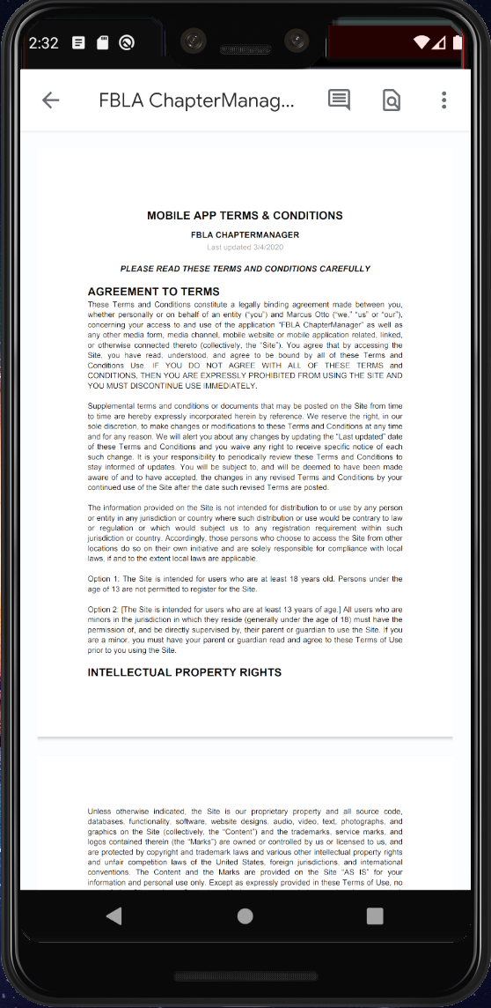
EULA
Copyright information
Licensing
Terms of service

Slide 7
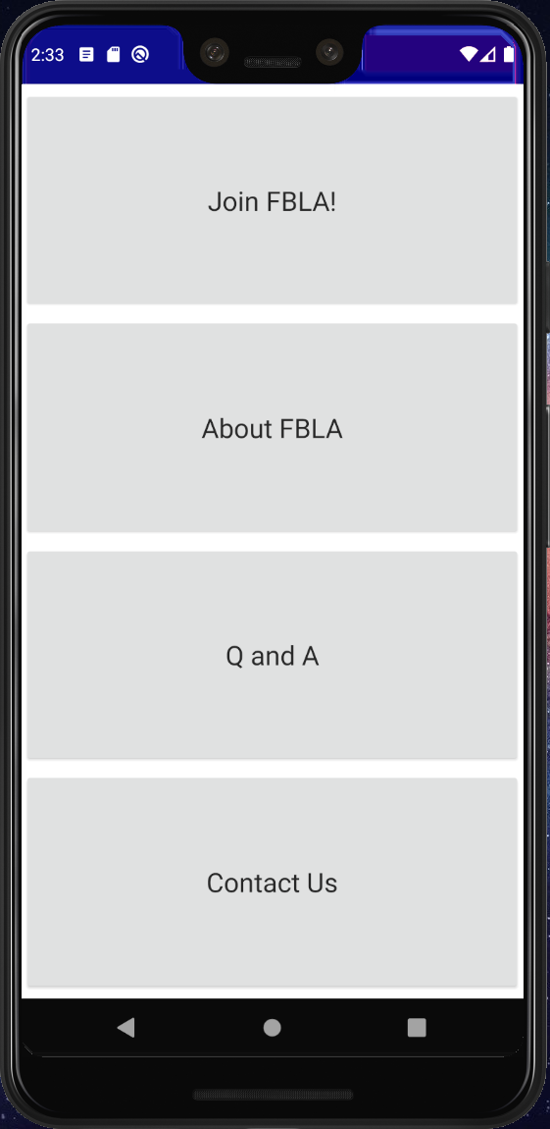
Public Resources
Join FBLA form for new members to sign up
About FBLA to share important information with potential new members
Q and A to answer commonly asked questions about FBLA
Contact Us to help the public easily contact the chapter advisor or see the twitter page

Slide 8
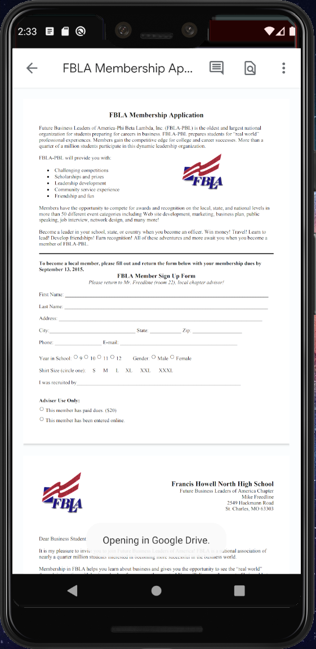
Join FBLA
Opens the form to join the FBLA chapter
Helps make sure that everyone has access to be able to join, reduces work for the chapter advisor

Slide 9
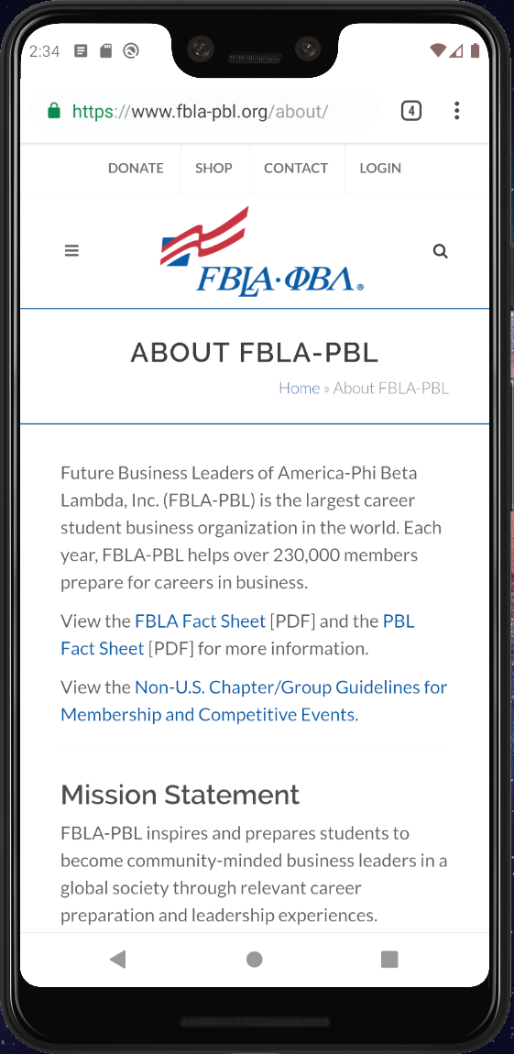
About FBLA
Links to the FBLA website’s about page in order for anyone who is curious to see what FBLA is all about

Slide 10
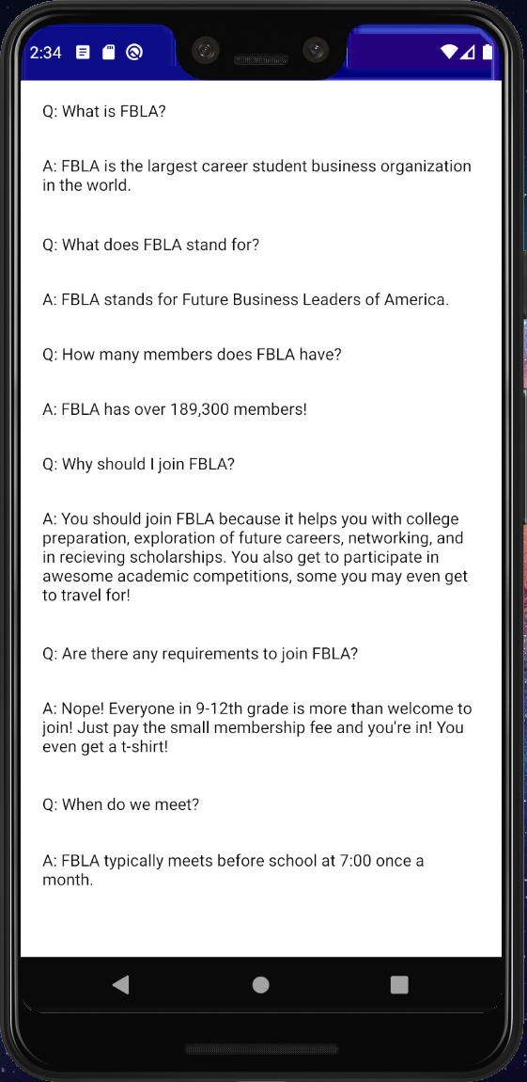
Q and A
Quickly and easily answers common questions of people unfamiliar with FBLA, reducing the number of repeat questions the club advisor is asked.

Slide 11
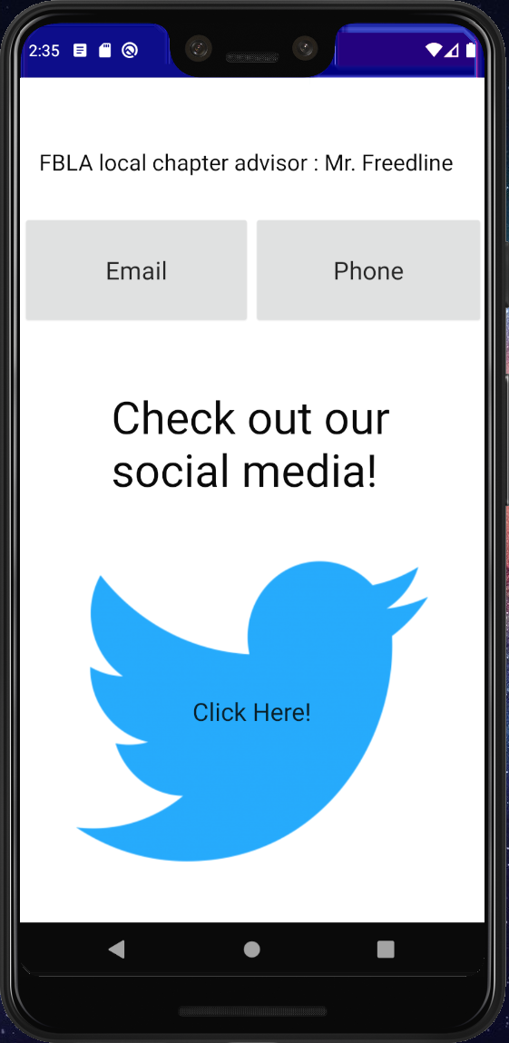
Contact Us
Anyone who has questions for the chapter advisor can easily contact them through phone or email
Social media is also easily accessible, allowing the public to see what is going on

Slide 12
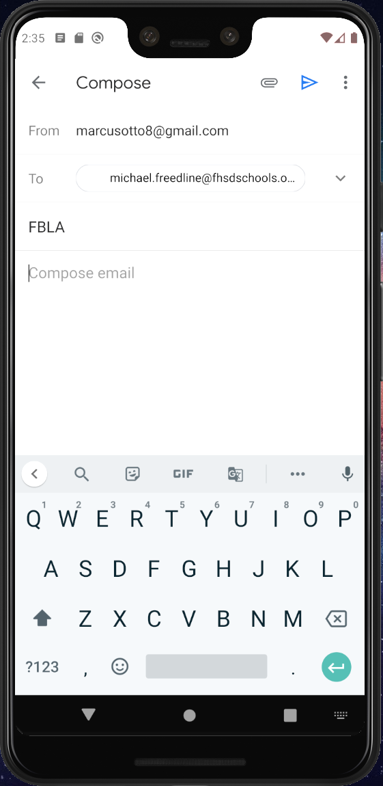
Email
Clicking email opens your designated email application, automatically filling with the chapter advisor’s email and the subject as “FBLA”

Slide 13
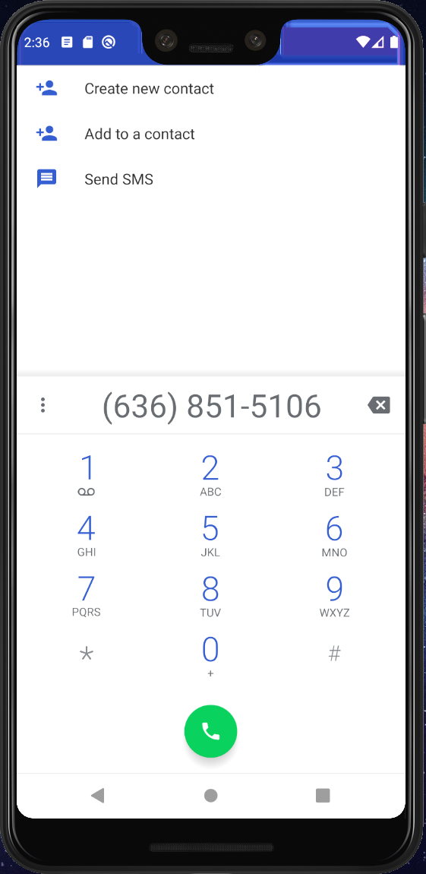
Phone
Any more urgent questions can be directed to chapter advisor via phone by clicking the phone button
Your designated calling app opens, dialing the work number for the chapter advisor

Slide 14
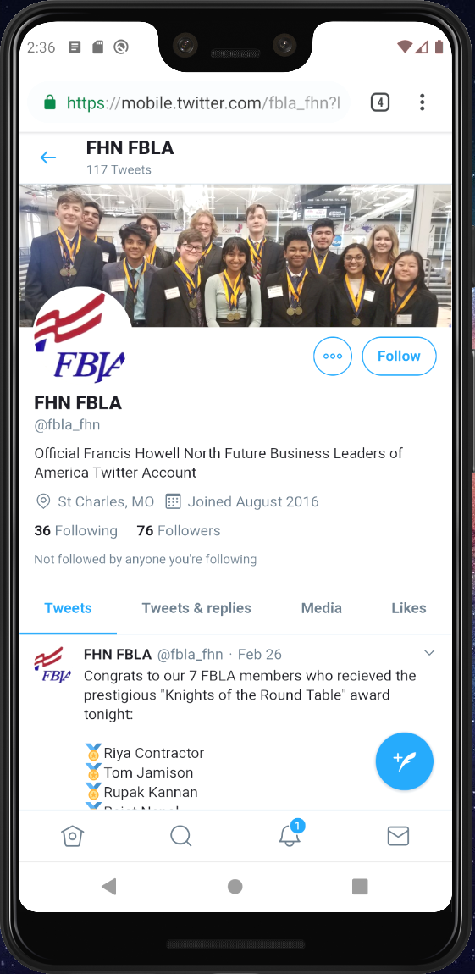
Twitter
Clicking the Twitter logo opens the FHN FBLA Twitter page, allowing users to see what is going on in the chapter.

Slide 15
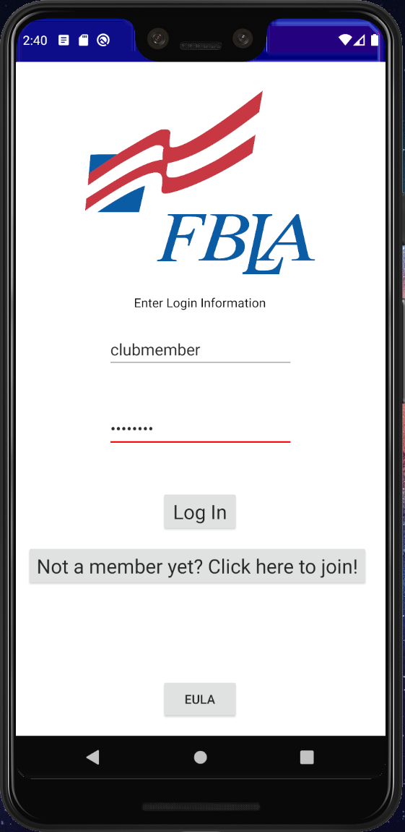
Club Member Login
Logging in using the club member login allows users who have joined the chapter to access more screens

Slide 16
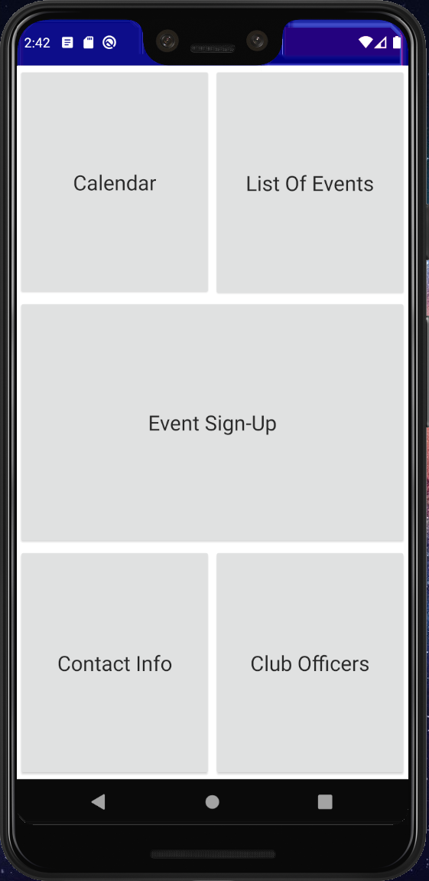
Club Member Screens
Club members log in to access all the resources a member would need
They can access a calendar of events, a list of competitive events, a signup sheet for the events, contact information, and a list of club officers

Slide 17
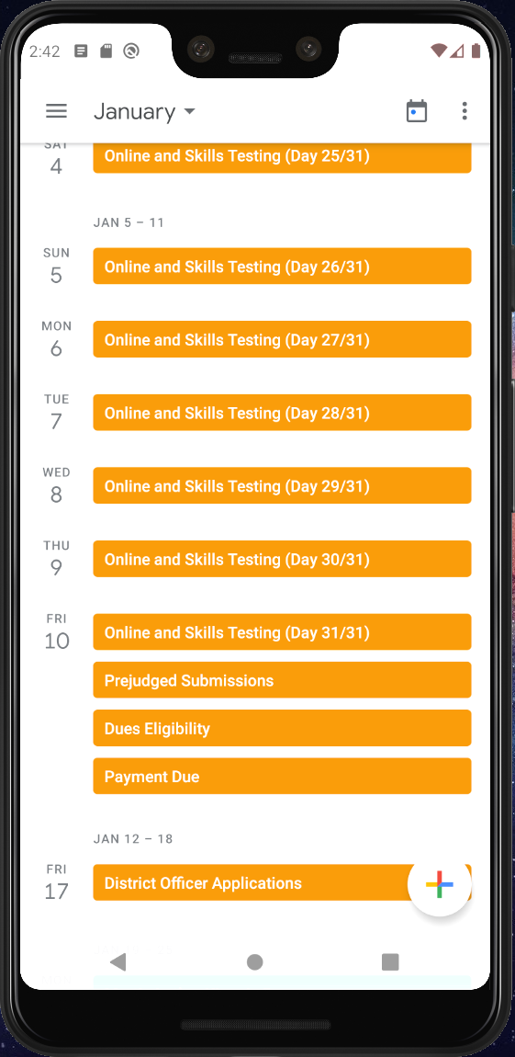
Calendar
Club members can access a google internet calendar with all of the year’s events in it. These events can be added to their own personal calendar as well through the link.

Slide 18
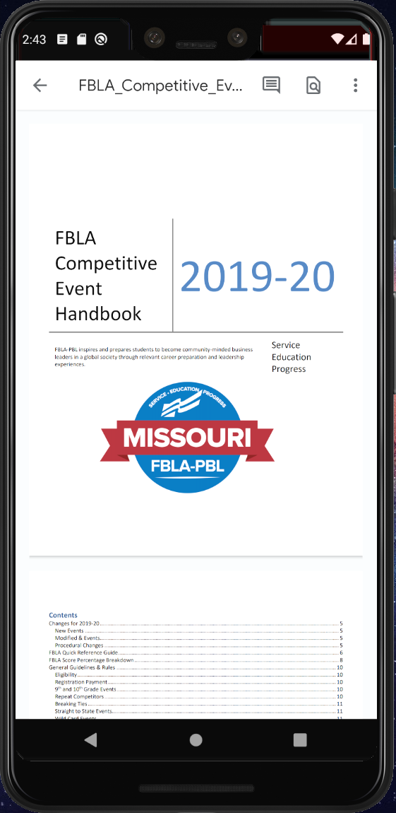
List of Events
This links to the FBLA competitive event handbook, helping members to learn more about the events in order to choose the right one for them

Slide 19
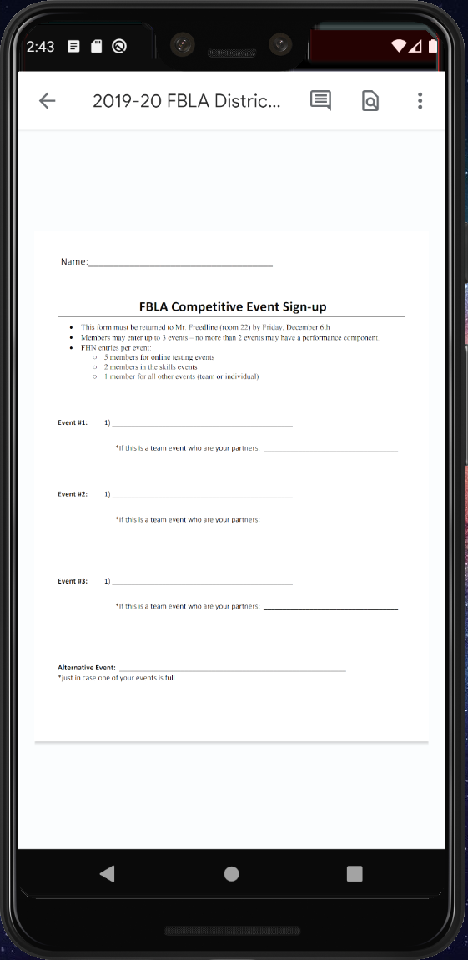
Event Sign-up
Club members can use this form to sign up for any competitive events they are interested in

Slide 20
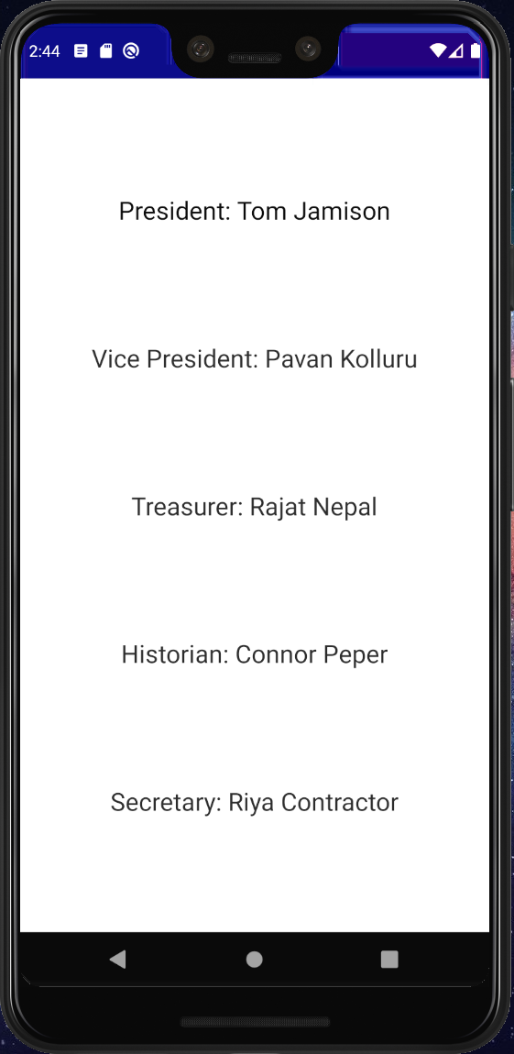
Club Officers
In case any members of the club need to talk to an officer, they can use this page to figure out who to talk to

Slide 21
Contact Info
This is the same screen as shown earlier in “Contact Us”

Slide 22
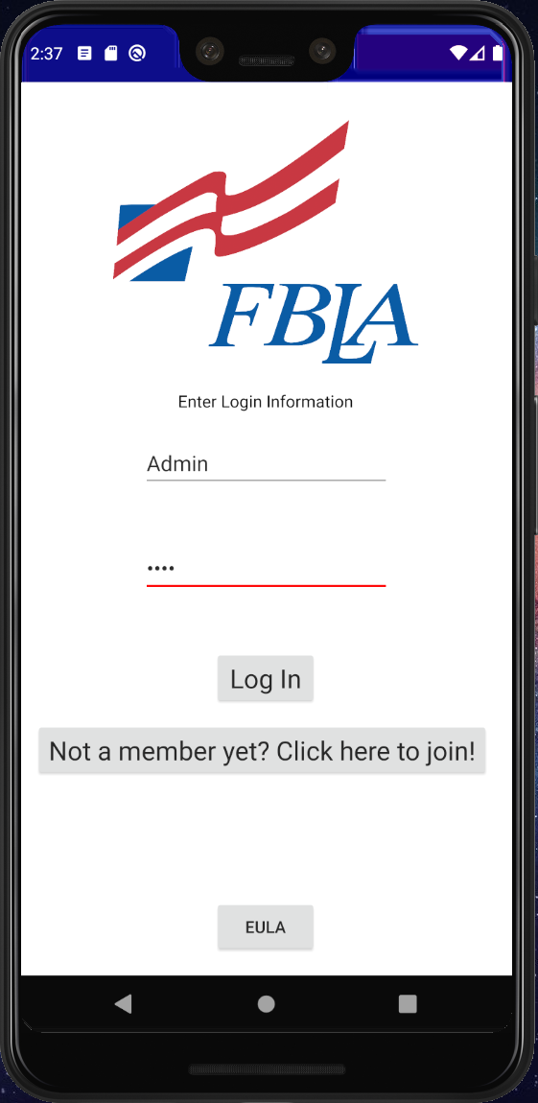
Chapter Advisor Login
Logging in using the chapter advisor login allows the chapter advisor to access the attendance screen

Slide 23
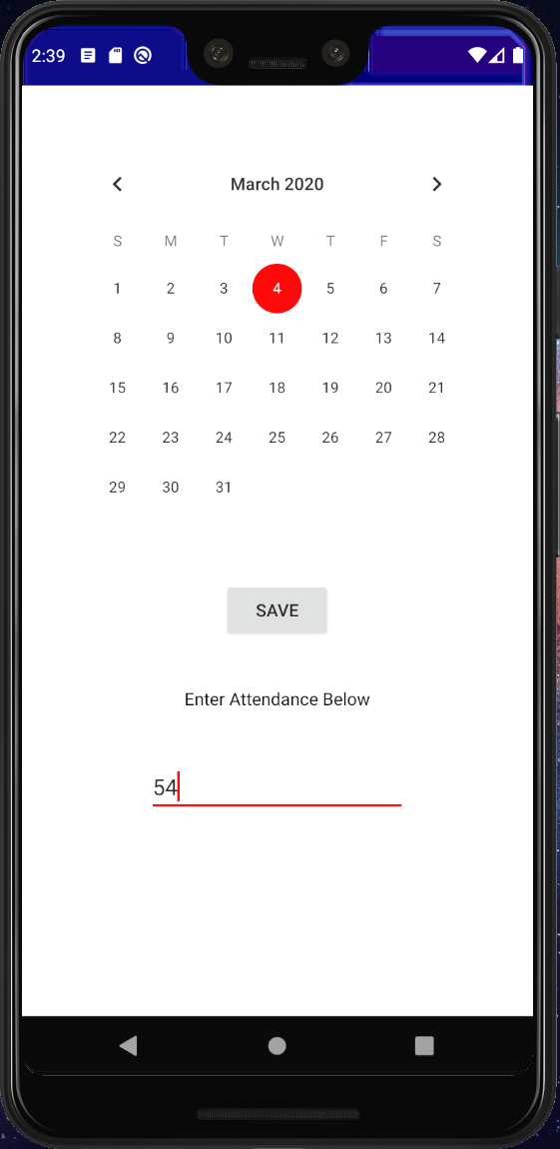
Attendance Calendar
On this screen, the chapter advisor can easily record, save, and access the attendance of each meeting simply by selecting the meeting date on the calendar

